Slide 1


QIB UI Automation – AccelQ Adoption Proposal
Author: Pi
Date: 2025.05.28

Slide 2


CONTENTS
1. Objective
2. Approach
3. Current Accomplishments
4. Outcome of POC
5. Future Goals
6. Potential Benefits
7. Cost Analysis
8. Final Ask

Slide 3


01
Objective

Slide 4


Objective
Clearly define the goal: Automate Cirrus and OBM UI & E2E Flows using AccelQ to increase test coverage, efficiency, and reduce manual effort.

Slide 5

02
Approach

Slide 6


Approach
Mention evaluation of multiple tools with AccelQ selected due to its low-code interface, ease of use, and internal adoption across teams.

Slide 7

03
Current Accomplishments

Slide 8


Current Accomplishments
Automated UI flows for Member Group, Cirrus, and OBM
Coverage includes login, guided UI, contract option checks, PDF validations, data retrieval, and complex navigations across 12+ UI screens
Database validation and integration with AccelQ reporting features

Slide 9


04
Outcome of POC

Slide 10


Outcome of POC
Successfully automated multiple UI elements (e.g., radio buttons, tabbed UI, popups, PDF validations)
Demonstrated ability to scale across Cirrus and OBM platforms

Slide 11


05
Future Goals

Slide 12



Future Goals
1
2
3
E2E Flow Automation
Integration
Regression Suite
Extend E2E flow automation from OBM → Cirrus → B&E Portal
Integrate with Jenkins, Excel, and Kafka using full AccelQ license
Expand regression suite automation

Slide 13


06
Potential Benefits

Slide 14




Potential Benefits
Testing Efficiency
Issue Detection
Resource Dependency
QA Improvement
Reduce manual testing effort
Early detection of issues, better ROI
Improve coverage and QA velocity
Reduce dependency on skilled automation resources

Slide 15

07
Cost Analysis

Slide 16
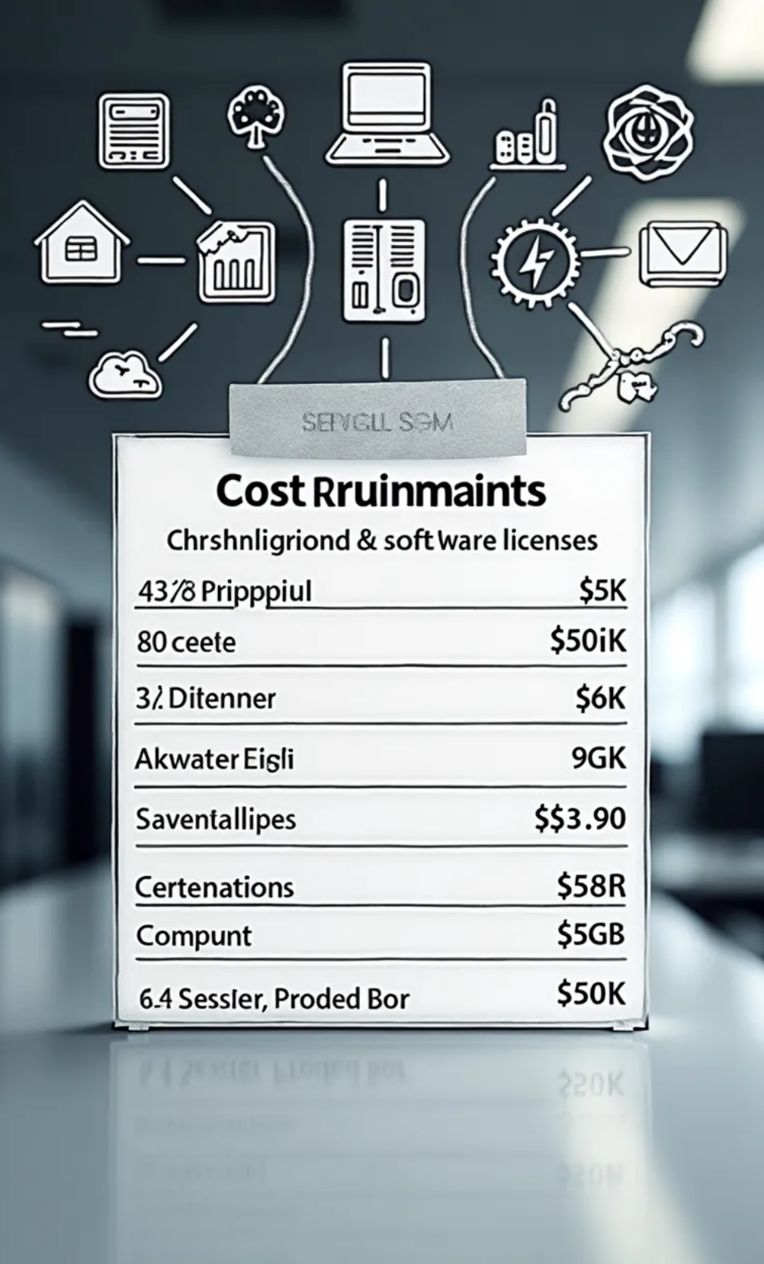

Cost Analysis
1
License Cost
2
Total Cost
$5K/year per license
Total: $40K/year for 8 licenses
3
Server Cost
4
Test Support
Additional server cost TBD
System supports up to 40 parallel tests (32-core, 90GB RAM server)

Slide 17
08
Final Ask

Slide 18


Final Ask
Approval for 8 AccelQ licenses + 1 server
Enable scalable UI automation for Cirrus and OBM applications

Slide 19

Thank You

